Slide 1




Predicting the Impact of Social Media Usage on Mental Health
Exploring the empirical relationship between social media usage and its impact on mental well-being through data science.
Vinodh kumar G – AA.SC.P2MCA2301004 – 07-02-2025

Slide 2


Social Media & Mental Health
Impact of Social Media on Mental Health

Slide 3





Comprehensive Table of Contents
1.
2.
3.
4.
5.
Introduction
Course Overview
Project Overview
Problem Definition
Requirements
An overview of the presentation's goals, setting the stage for the discussion to follow.
A detailed outline of the course structure, highlighting key objectives and learning outcomes.
A summary of the project’s scope, objectives, and significance in the broader context.
An articulation of the core problems being addressed in the project, including background context.
An outline of the specific hardware and software requirements necessary for project execution.

Slide 4
Introduction to Social Media Addiction Analysis
This project is part of the IBM Data Science Capstone, focusing on applying data science methodologies to real-world scenarios. The course encompasses critical aspects such as data collection, preprocessing, exploratory data analysis (EDA), machine learning, and visualization techniques.
Course Overview
Social media addiction is increasingly recognized as a significant concern in modern society, impacting mental health, productivity, and daily activities. This project aims to analyze social media usage and its psychological effects through machine learning models, utilizing data science techniques to predict addiction levels and uncover behavioral patterns.
Project Overview
The rise in social media usage has sparked concerns regarding its effects on mental health. Many individuals report spending an excessive amount of time on these platforms, which can lead to reduced productivity, sleep issues, and social isolation. Understanding addiction levels and the psychological factors involved is vital for creating effective interventions.
Problem Definition
The study aims to quantify social media addiction through an addiction score, identify key behavioral patterns linked to excessive usage, and develop a machine learning model to predict addiction levels based on user responses. These objectives will provide insights into the behavioral dynamics of social media users.
Objectives of the Study

Slide 5








System Design
1.
Data Collection
5.
Machine Learning Model
The project utilizes a publicly available dataset from Kaggle, which captures user responses regarding social media usage habits, psychological factors, and demographic information. This comprehensive dataset serves as the foundation for the analysis of social media addiction.
A Random Forest Classifier is trained to predict social media addiction among users. The model's performance is evaluated using accuracy metrics, classification reports, and confusion matrices, ensuring its effectiveness in making predictions.
6.
Evaluation Metrics
2.
Data Preprocessing
To measure the performance of the model, the ROC curve is plotted, offering a visual representation of the trade-off between sensitivity and specificity. This is essential for assessing the model's predictive capabilities.
The preprocessing phase includes handling missing values and eliminating duplicate records to ensure data integrity. Categorical variables are encoded using Label Encoding to facilitate analysis, while social media usage time is converted into numerical values using predefined mappings for consistency.
7.
Dimensionality Reduction & Clustering
Feature Engineering
PCA (Principal Component Analysis) is applied to reduce dimensionality for data visualization, making it easier to interpret the results. K-Means clustering is then utilized to categorize users into high and low addiction groups, providing valuable insights into user behavior.
3.
An addiction score is computed based on responses to various behavioral questions. This score will help in quantifying the level of addiction among users, providing a basis for further analysis and modeling.
8.
Model Deployment
4.
Exploratory Data Analysis (EDA)
Deploying the machine learning model involves integrating it into a production environment to make predictions on new data. This project utilizes GitHub as the repository for model deployment, facilitating version control, tracking changes, and collaboration with other developers. This approach ensures the model remains current and accessible for future enhancements.
EDA is conducted to understand the dataset better, analyzing aspects like Age Distribution and Time Spent on social media. Additionally, the relationship between Time Spent and Distraction levels is explored, along with the distribution of addiction scores. Visualizations such as correlation heatmaps and boxplots are used to reveal insights into feature relationships.

Slide 6
Implementation Details and Tools Used
Implementation Details and Tools Used
Tools Used:
Libraries:
pandas, numpy, matplotlib, seaborn, scikit-learn, plotly, Dash,Jupiter Notebook
Implementation Steps:
Data Preprocessing: Handling missing values, converting categorical variables.
EDA: Visualizing distributions and relationships
Feature Engineering: Creating an addiction score
Model Building: RandomForestClassifier
Evaluation: Accuracy, Confusion Matrix, ROC Curve
Visualization: Plotly and Dash for interactive dashboards
1.
.
6.
.

Slide 7
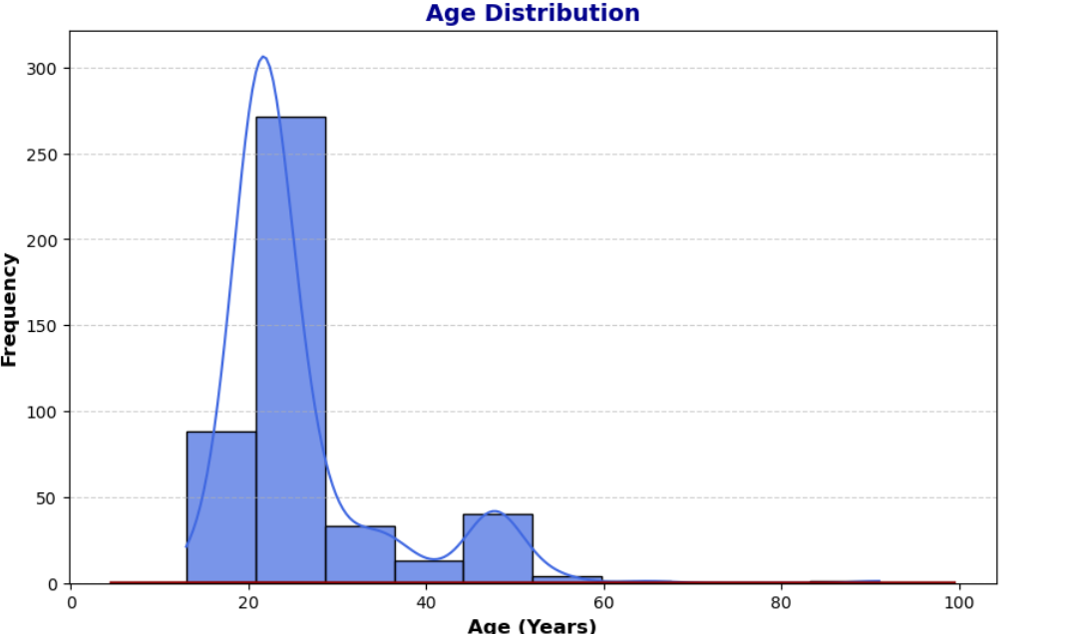
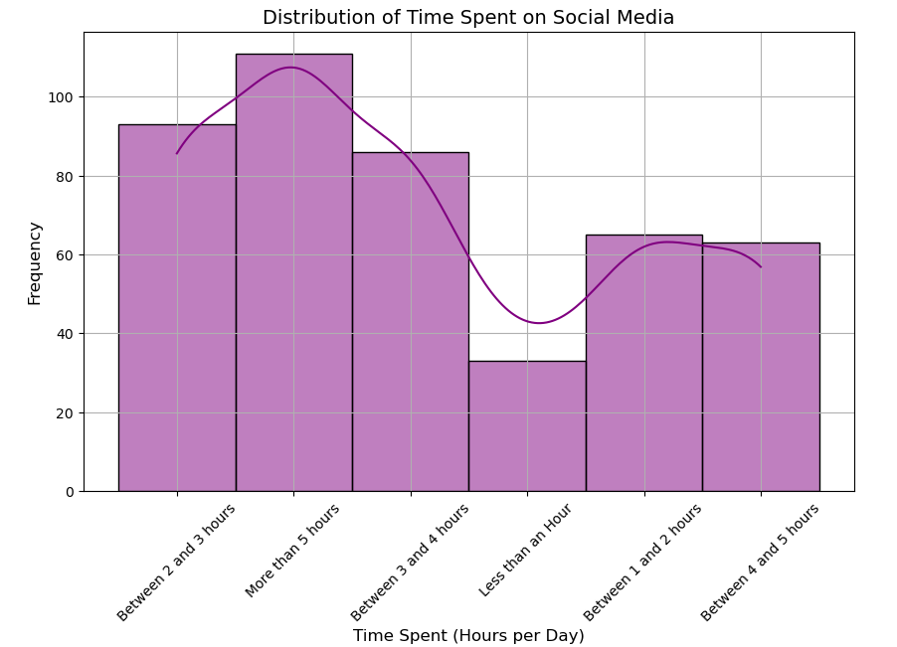
Results and Analysis
35%
Majority of respondents are in the 18-24 age group
60 minutes to 300 minutes
Time spent on social media varies widely

Slide 8
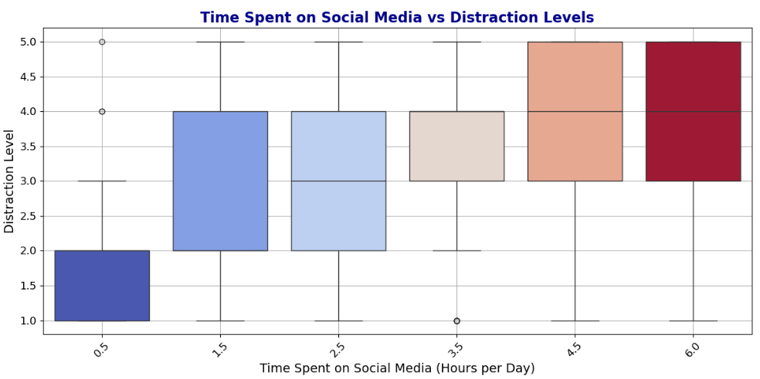
Results and Analysis
50%
Half of respondents report high distraction levels

Slide 9
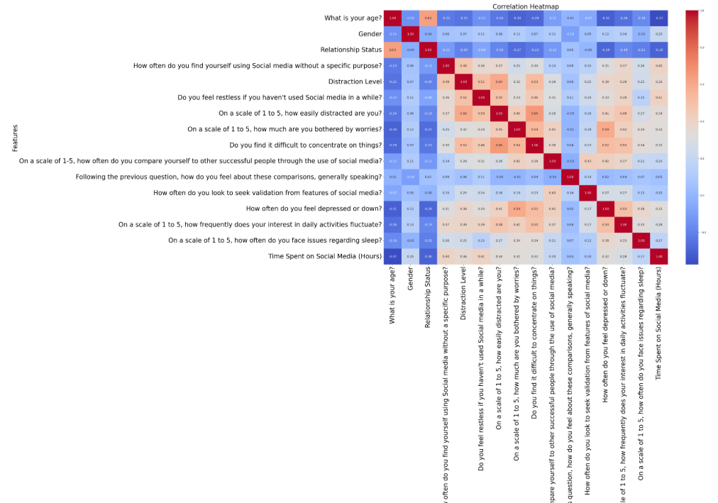
Results and Analysis
0.75 to 1
Strong correlation between social media usage and psychological factors

Slide 10


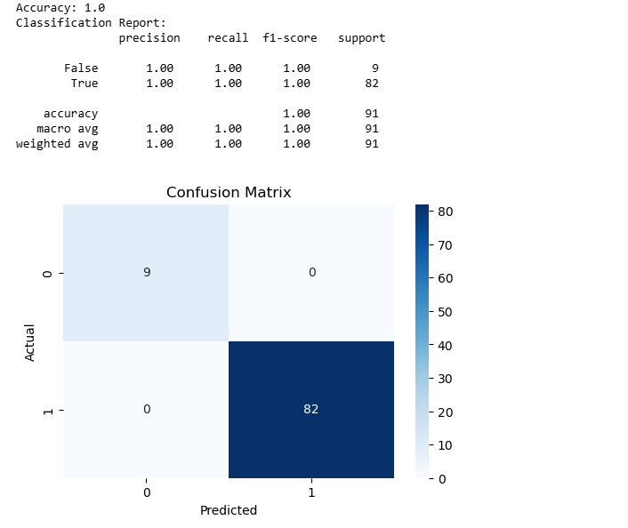
Model Performance
Random Forest Classifier Performance
The Random Forest Classifier achieved a high accuracy score in predicting social media addiction, demonstrating its effectiveness in distinguishing between addicted and non-addicted users. This model was evaluated using accuracy metrics, a detailed classification report, and a confusion matrix, all of which confirm its reliable performance.

Slide 11
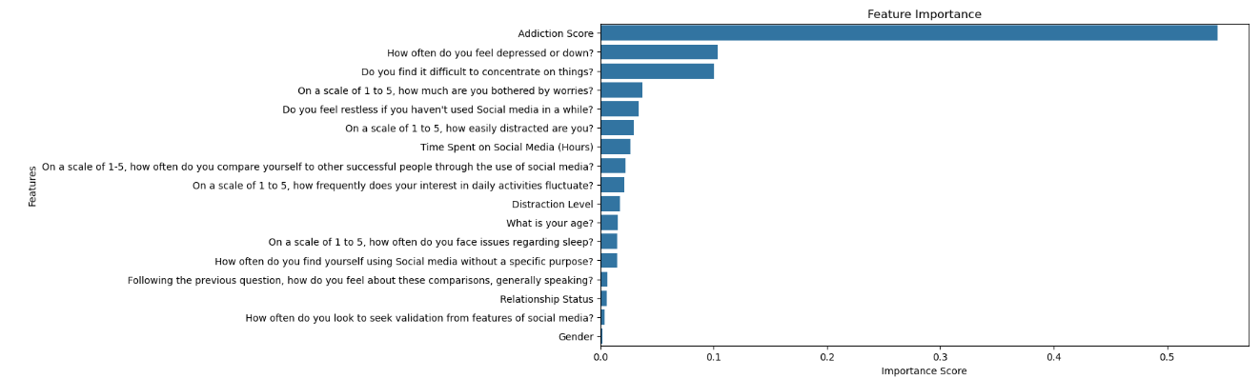
Model Performance
Analysis of Feature Importance
The analysis revealed that the most influential features in predicting addiction levels were social media usage duration, frequency of distractions, and validation-seeking behavior. Understanding these features is crucial as they provide insights into user behavior patterns that correlate with increased addiction.

Slide 12
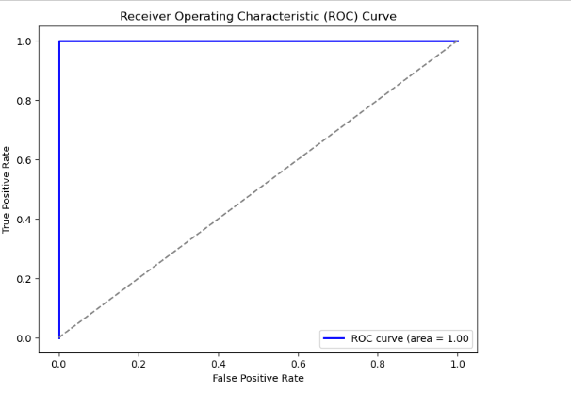
Model Performance
ROC Curve Interpretation
The ROC curve offered a visual representation of the model's performance, with the area under the curve (AUC) serving as a key indicator of the model's ability to effectively differentiate between addicted and non-addicted users. A higher AUC value signifies better model discriminative ability.

Slide 13
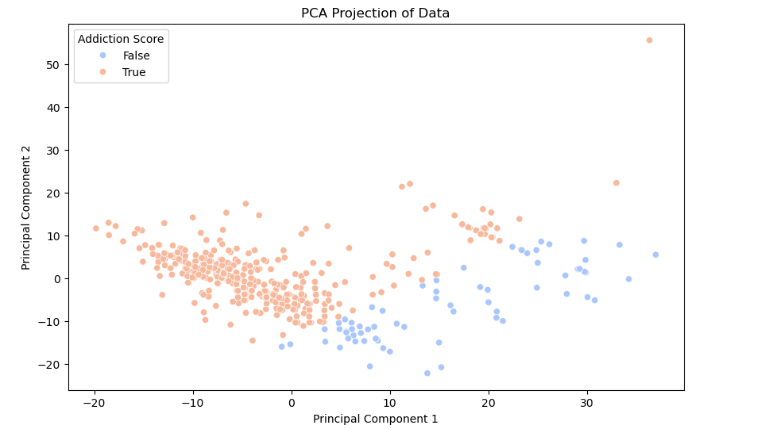

PCA Visualization
The Principal Component Analysis (PCA) visualization revealed distinct groupings of respondents, effectively showcasing variations in addiction levels among them. This dimensionality reduction technique simplifies complex data, allowing for better understanding and interpretation by visualizing it in a lower-dimensional space. This approach enhances the ability to identify trends and patterns that would be difficult to discern in higher-dimensional datasets.

Slide 14
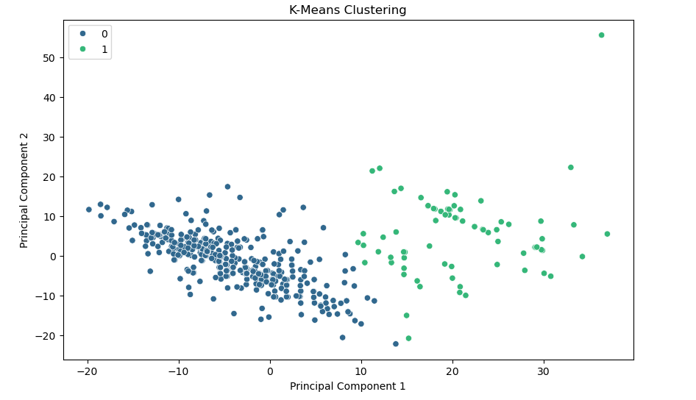
K-Means Clustering
K-Means clustering was utilized to effectively segment users into categories of high and low addiction risk. This technique identifies and groups respondents with similar addiction patterns, providing valuable insights into the behaviors and characteristics of different user segments. The results of this analysis can inform targeted interventions by highlighting potential groups that may benefit from specific support strategies.

Slide 15
Dash App for Interactive Visualization
1.
Dash App Overview
5.
Callback Functionality
An interactive dashboard was created using the Dash framework to visualize the relationship between social media usage and mental health. This dashboard allows users to filter the data by gender and view various aspects of the analysis through interactive graphs.
The callback function updates the graphs based on the selected gender filter. It filters the dataset accordingly and generates four interactive graphs using Plotly Express: age distribution, time spent vs. distraction level, addiction score distribution, and addiction score vs. time spent.
2.
Dash App Initialization
6.
Graph Summaries
The Dash app is initialized with app = dash.Dash(_{name}), creating an instance of the application. This sets the foundation for the interactive functionalities of the dashboard.
Each graph provides insights: Age Distribution shows demographic spread, Time Spent vs. Distraction illustrates correlations, Addiction Score Distribution indicates levels of addiction, and Addiction Score vs. Time Spent identifies patterns.
3.
Layout Design
The layout of the Dash app is defined using HTML and Dash components including html.Div for organizing the layout, a centered header for the dashboard, and a dropdown menu for selecting gender filters.
7.
Running the Application
The app is run in debug mode using if _{name} '_{main}': app.run_server(debug=True), which allows for real-time updates and interactive visualizations during development.
4.
User Interactivity
Users can select a gender filter using a dropdown menu with options like 'All', 'Male', and 'Female', allowing for tailored visual analysis based on user selection.

Slide 16
Challenges Faced
Problem Identification.
Finding Data
Handling missing values and inconsistencies.
Model Training
Understanding and communicating the model prediction and insights.
1.
.
6.
.

Slide 17
Conclusion
1.
Application of Data Science Methodologies
5.
Addiction Score
This study successfully demonstrated the application of data science methodologies and machine learning techniques in assessing social media addiction. The project provided valuable insights into the behavioral patterns associated with social media usage and its impact on mental health.
The addiction score distribution indicated that a significant portion of users exhibited high addiction tendencies, with slight variations observed based on gender, highlighting the need for tailored interventions.
6.
Machine Learning Model Performance
2.
Age Distribution and Demographics
The Random Forest Classifier achieved a high accuracy score, demonstrating its effectiveness in predicting social media addiction. The analysis of feature importance revealed that social media usage duration, frequency of distractions, and validation-seeking behavior were the most influential factors.
The age distribution chart revealed the demographic spread of respondents, providing a clear picture of the sample population's age groups, which is essential for understanding the target audience's characteristics.
3.
Time Spent on Social Media
7.
Dimensionality Reduction and Clustering
The distribution of time spent on social media highlighted the varying levels of usage among respondents, with some individuals spending a significant amount of time on social media platforms, indicating potential addiction risks.
PCA visualization and K-Means clustering effectively segmented users into high and low addiction risk categories, providing clear visual groupings and insights into addiction patterns.
4.
Behavioral Patterns
8.
Interactive Dashboard
The analysis showed a strong correlation between social media usage and distraction levels, indicating that higher social media usage tends to correlate with increased distraction, impacting productivity and mental well-being.
The interactive dashboard created using Dash enhanced the project's interactivity, allowing users to explore the data through dynamic visualizations. This user-friendly interface made the findings more accessible and engaging, providing a valuable tool for further analysis and exploration.

Slide 18



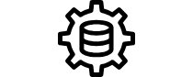
References
Scikit-learn Documentation
Seaborn Library
Pandas Documentation
Coursera IBM Data Science
The official documentation for Scikit-learn provides comprehensive information about machine learning in Python. It includes user guides, API references, and tutorials, making it a valuable resource for both beginners and experienced practitioners. Access it at: https://scikit-learn.org
Seaborn is a powerful visualization library for Python based on Matplotlib. The documentation offers detailed guidance on creating informative and attractive statistical graphics. For more details, visit: https://seaborn.pydata.org
Pandas is an essential library for data manipulation and analysis in Python. Its documentation includes tutorials, API references, and practical examples that can help users efficiently handle data structures. Find the documentation here: https://pandas.pydata.org
The IBM Data Science Professional Certificate on Coursera offers a comprehensive curriculum covering various aspects of data science, including data analysis, visualization, and machine learning. This is a great resource for learners seeking structured education in data science. Explore the course at: https://www.coursera.org/professional-certificates/ibm-data-science

Slide 19
1.
.
6.
Q&A
.

Slide 20
1.
.
6.
Thank you ☺
.

